Slide 1
BASIC DETAIL OF TEAM AND PROBLEM STATEMENT
PROBLEM STATEMENT TITLE: Crop yield predictions and optimization
TEAM NAME: REJUVENATE
TEAM LEADER NAME: LIKHITHA D M
INSTITUTE NAME: SIDDAGANGA INSTITUTE COLLEGE
THEME NAME: AGRITECH AND SUSTAINABILITY Smart Recycling Tracker

Slide 2
PROBLEM STATEMENT :
Modern agriculture faces pressing challenges such as climate unpredictability, resource scarcity, and soil degradation, all while trying to meet growing food demands. Traditional methods often lack the precision to adapt effectively. This project proposes a machine learning-based solution to predict crop yields and recommend optimal crops using environmental and historical data. By offering accessible, data-driven insights, it aims to empower farmers with sustainable, efficient decision-making tools.
PROPOSED SOLUTION:
This project focuses on developing a comprehensive, user-friendly platform powered by machine learning to support modern farming. It will accurately predict crop yields using historical and environmental data, enabling better planning. The system will also recommend the most suitable crops for specific soil and climate conditions, boosting productivity and profitability. Additionally, it will offer insights on efficient resource use—such as water, fertilizers, and seeds—to reduce waste and environmental impact. Designed for accessibility, the platform will empower farmers and agricultural stakeholders with practical, data-driven tools to enhance sustainability and decision-making.

Slide 3
TECHNOLOGY STACK:
1. Programming Languages:
Python for machine learning model development and data processing. JavaScript for the interactive web interface.
Libraries and Frameworks :
TensorFlow and Scikit-learn for implementing machine learning models.
Pandas and NumPy for data manipulation and analysis.
Flask for backend API development.
React.js for frontend user interface.
Database and Storage:
PostgreSQL for storing historical data and real-time inputs.
Cloud-based storage solutions for scalability and accessibility
Algorithmic Approach:
Neural Networks – Used for high-accuracy crop yield prediction by identifying complex patterns in historical data.
Random Forest – Utilized for crop recommendation by analyzing multiple environmental factors.
Regression Analysis – Helps in determining yield trends over time

Slide 4
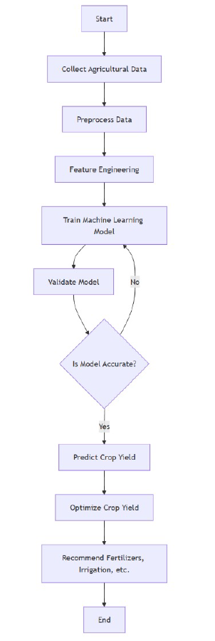

Slide 5
APPLICATION:
Real-Time Crop Recommendations: The system uses live environmental data—like temperature, soil moisture, and rainfall—to suggest the most suitable crops for specific conditions, helping farmers make timely and accurate decisions.
Web-Based Farmer Interface: A user-friendly web application was developed, allowing farmers to easily access crop predictions and recommendations anytime, bridging the gap between technology and practical farming.
Optimized Resource Usage: The system provides guidance on the efficient use of water, fertilizers, and land, reducing waste and promoting sustainable farming practices.
Improved Farm Productivity: By supporting better crop management decisions, the platform helps increase yield and profitability, reducing risks associated with traditional guesswork.
Foundation for Future Smart Farming Tools: The project lays the groundwork for integrating advanced technologies like IoT, satellite data, and mobile access to create a complete precision agriculture system.

